Slide 1
From a questionable 29.5 kN to a capacity-adaptive surrogate
SAFEGO US-1 · 3DEC RIGID-BLOCK MODEL · PROGRESS NOTE
The base-shear mismatch, what it did to the calibration, the rebuilt wall and its pushover, and the fixed-point Route 2 now running.
Yopi · 20 October 2026
Moshfeghi et al. (2024) Structures 66:106815 · US-1 = Test 9
Notes:
Three parts: why the 29.5 kN capacity could not be right and what that did to the model; the rebuilt wall with f_t = 0 and the single spring load, and its pushover; the fixed-point target that replaces T_eff, and the two sequences launched today.

Slide 2

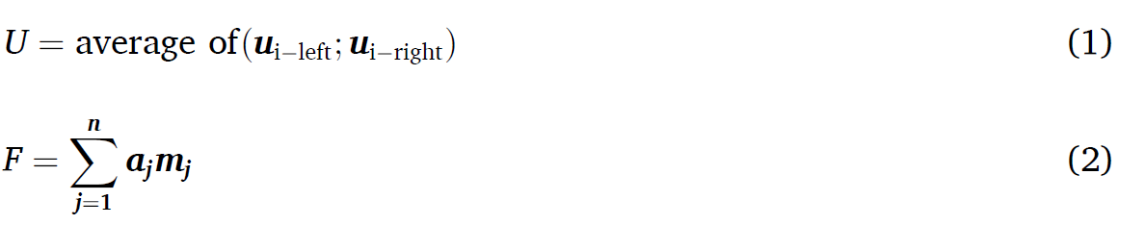
A 1.3-tonne wall cannot carry 3 tonnes of base shear
1 · THE BASE-SHEAR QUESTION
Paper, Table 4 · US-1 run 24
Same Eq. 2, the group’s masses, absolute channels
Where the old 29.5 came from
29.5 kN
× 2.3
11 kN
Eq. 2: Σ a_j·m_j over three accelerometers. The old model was calibrated to it.
A mass factor fitted to reach 29.5, plus the table acceleration counted twice.
455 / 670 / 606 kg, no factor. Plateau 8.3–11.6 kN over runs 16–24.
Pending Alvand Moshfeghi’s reply on the masses behind Eq. 2. Until then: test capacity ≈ 10 kN.
Moshfeghi et al. (2024) Eq. 2, Table 4 · masses: group sheet of 5 Oct 2026 · make_processed_globalzero_v2.py
Notes:
The paper's 29.5 kN cannot be rebuilt from Eq. 2 with any stated mass; the group's own recipe gives 11 kN. Everything that follows assumes about 10 kN until Alvand replies.

Slide 3

Two errors, pushing the same way, made 29 kN look right
1 · WHAT THE WRONG NUMBER DID TO THE MODEL
A · SPRING LOAD DOUBLED
B · BONDED JOINTS
0.134 MPa
f_t = 0.344 MPa
instead of the test’s 0.096. Rocking capacity scales with overburden: +40 % before any material entered.
M_cr = (σ_v + f_t)·b·t²/6 → 16·M/h = 25.9 kN. Pushover gave 25.8. The test never had that plateau.
Control, Route 2 and Method 2 v11 all ran on this wall. None of them is comparable with the rebuild; the comparison restarts from the new control.
ncstav averages base + joist-support force over 0.386 m² and is not a base stress (0.0757 MPa now, 0.103 on the old build); base-only check: 26.0 kN / 0.096 MPa
Notes:
The doubled springs alone put the kinematic capacity at 14.6 kN instead of 10; the bond held the wall at 26 kN until the base cracked. Together they made 29 kN look right.

Slide 4
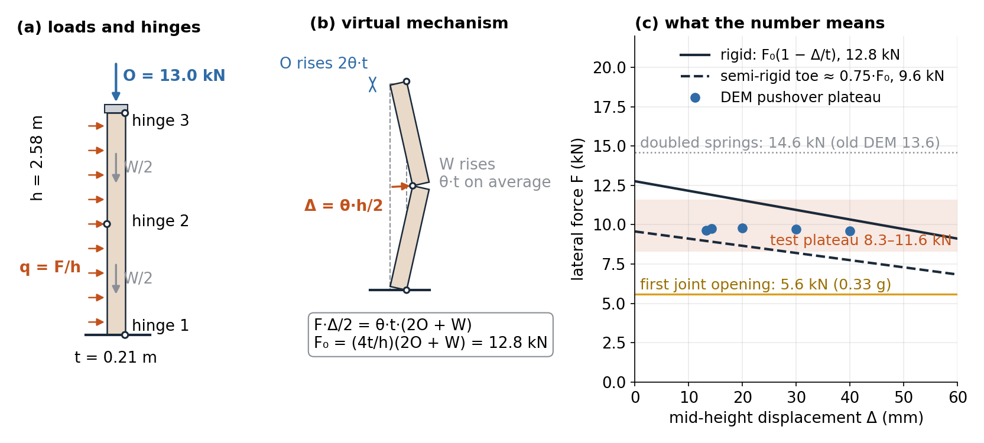
Geometry × overburden puts the plateau near 10 kN
2 · WHAT THE WALL CAN CARRY, BY HAND
t 0.21 m, h 2.58 m, W 13.2 kN, O = 10.35 + 1.18 + 1.49 kN · rigid 12.8 kN, semi-rigid toe 9.6 kN · first opening 5.6 kN (0.33 g); a_c ≈ 0.55–0.60 g, first crossed at run 19
Notes:
Nothing here depends on the joint model: the plateau is geometry times overburden. The test band and the rebuilt DEM both sit inside 9.6 to 12.8 kN. With the doubled springs the same formula gives 14.6, next to the old DEM's 13.6.

Slide 5

Three independent readings put f_t at zero in the specimen
2 · WHAT THE TEST SAYS ABOUT THE BOND
≤ 0.06 MPa
+17.5 %
> 0.3 g
from the plateau
period, gradual from run 1
cracking reported
8–11 kN from run 16 at 4.8 mm. A bonded wall would need 26 kN to open.
Table 5: 0.091 → 0.107 s, near-linear. No step at a cracking run.
§3.2 — at the first-opening threshold of an unbonded wall (0.33 g).
0.28 / 0.41–0.45 MPa are companion-specimen values. “Healthy to run 19” is the overburden holding the wall, bond or no bond.
Moshfeghi et al. (2024) Table 5, Fig. 14, §3.2 · plateau from the v2-processed base shear · two-brick joint test on the mason joint: brittle, zero by 0.4 mm
Notes:
None of the three readings alone is decisive; together they leave no room for 0.344 MPa in the wall as tested. The mason UDM has an explicit tension = 0 branch, so this is a parameter change, not a model change.

Slide 7
Same geometry, same contacts, four settings changed
3 · THE REBUILT MODEL
Setting | Old build | Rebuilt (ft0) | Verified by
Spring load | 2 × 10.35 kN, face traction or density | 10.35 kN applied force on T_B | force read back −10 350 N; base 26.0 kN
Joint tension | 0.344 MPa, c 0.75 MPa | 0 (UDM branch), c 0.2 MPa, Gs 100 J/m² | two-brick joint test; tension read-back
Strain mode | small | large | follower-load runaway fixed by the applied force
Damping | none (ξ = 0.0002 measured) | Maxwell 1.5 %, flat 1–25 Hz | ring-down: 1.4–1.66 % across the band
Ring-down, rebuilt wall
Masses in the check
Joists
T1 = 0.103 s
1308 + 76 + 213 kg
on rollers, as tested
Part_I_MASON_v8_LargeStrain_springforce_ft0.sav · masonry / joist share into the wall / beam
Notes:
Four changes, each traceable to a check. No contact stiffness was touched.

Slide 8

Gravity tilt loads everything; the masonry-only push loads the wall
3 · TWO WAYS TO PUSH THE WALL
GRAVITY TILT (V4)
MASONRY-ONLY PUSH (V5)
g rotated: a·m on every block
block.force.app = a·m on the 1308 kg of masonry
Wall, beam and joists all feel the lateral acceleration. The joists lie along the push direction, so a sustained force slides them out of the pocket at 17 mm (pocket_open 281 mm). A shake table reverses that force every half-cycle; a static push never does.
Gravity stays vertical; joists and beam are loaded only through their contacts with the wall. The joists keep bearing (joist N 3.0 → 4.7 → 4.2 kN) and the curve runs to 81 mm. This is the wall’s own capacity, which is what the backbone needs.
Same servo, same reactions (F_tot = base + joist supports + top joint), same 10 kN plateau up to the point where v4 lost its joist. The dynamic runs still carry joist inertia; only the static backbone leaves it out.
pushover_oop_3dec_v4 (gravity tilt, ±) · v5: po_push FISH, POCKET_EXIT_MM abort guard, masonry mass from block.mass
Notes:
The v4 joist walk-out is an artefact of a static body force on a free-sliding element, not a wall property. v5 removes it by loading only the wall; joist inertia belongs to the dynamic runs, where it reverses.

Slide 9
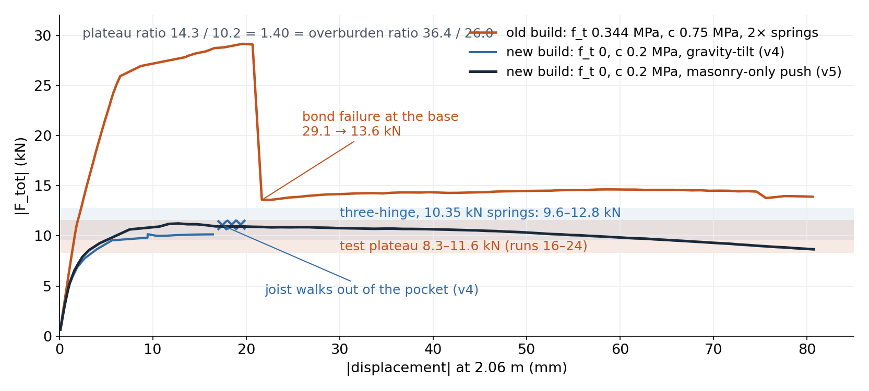
29 kN was the bond; 10–11 kN is the wall
3 · OLD VS NEW PUSHOVER
K1 6.1 / 5.3 / 5.1 kN/mm → T1 0.095 / 0.103 / 0.104 s · plateau 20–60 mm: 14.3 / – / 10.7 kN · top-joint shear plateaus at 6.8 / 3.7 kN (ratio 1.84 = ratio of top normal forces)
Notes:
The old curve is the bonded wall until the base cracks, then the over-strong rocking wall. The new curve is the rocking wall from the start. The 1.40 plateau ratio equals the overburden ratio, an independent confirmation of the doubled springs.

Slide 10
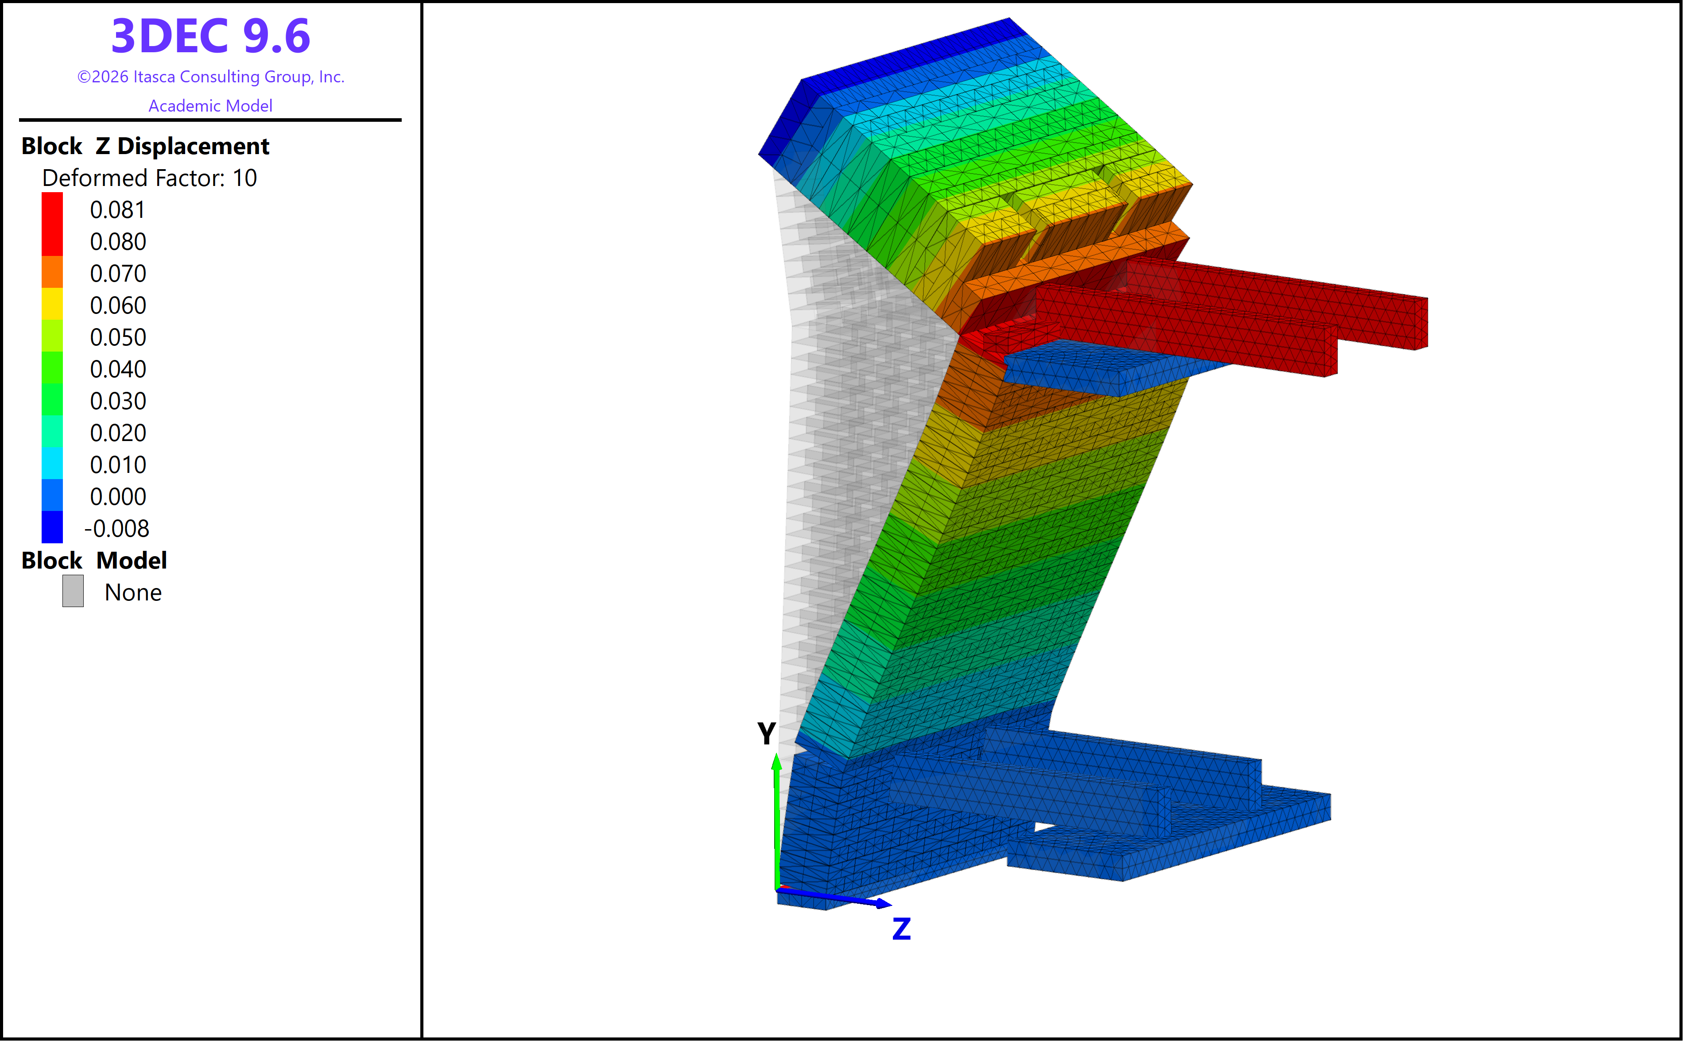



One rigid rotation about the base, sliding under the beam
3 · DEFORMED SHAPE AT 81 MM (× 10)
Straight wall, hinge at the base. Displacement grows linearly with height: no mid-height hinge, unlike the test’s bulged Fig. 15 shapes.
Top course slides under the fixed beam. The beam stays at zero; the top joint carries 3.7–6.8 kN of friction. That is the F_top plateau.
Upper joist travels with the wall, 80 mm along its support. The lower joist stays. The pocket drags one joist and releases the other.
Block Z displacement, deformed factor 10, old build at the end of the gravity-tilt push · the mechanism to compare against Fig. 15 before trusting the three-hinge reading
Notes:
The important thing in this picture is what is not there: no mid-height hinge. The pushover mechanism is base rocking plus top sliding, so the plateau is partly a top-joint property. Compare with the test's deformed shapes before the three-hinge hand calculation is used as more than a bound.

Slide 11
The bilinear gives T_eff = 0.73 s for every run
4 · WHY A SINGLE T_EFF FAILS ON THIS CURVE
Ductility-based period
Run | Record × s | d* (mm) | s·Sd(0.73 s)
1 | HU12 × 0.5 | 0.45 | 1.8
3 | EC40 × 0.2 | 0.40 | 14.6
11 | EC40 × 0.5 | 2.0 | 36.5
19 | HU12 × 5.0 | 8.95 | 18.5
22 | FR76 × 1.0 | 29 | 45 (tipping 40)
25 | FR76 × 2.0 | 61 | 90 (tipping 65)
T_eff = T1·√μ
d_y 2.5 mm, d_u 75 mm → μ ≈ 30 → 0.7 s. Right for a run that reaches d_u; meaningless for run 1 at 0.4 mm.
On a rocking backbone
No yield point: the secant period runs continuously from 0.10 to 0.73 s. A single μ is arbitrary.
Kept in the paper as the standard N2-style variant — with this table as the reason it cannot work here.
d* with m_eff = 1635 kg · orange: an elastic run targeted past the knee, or a target beyond the tipping point
Notes:
EC40 is the decisive row: run 3 is elastic in the test and in every model, and the single T_eff would target it at 14.6 mm. Every FR76 target lands beyond the tipping point.

Slide 12
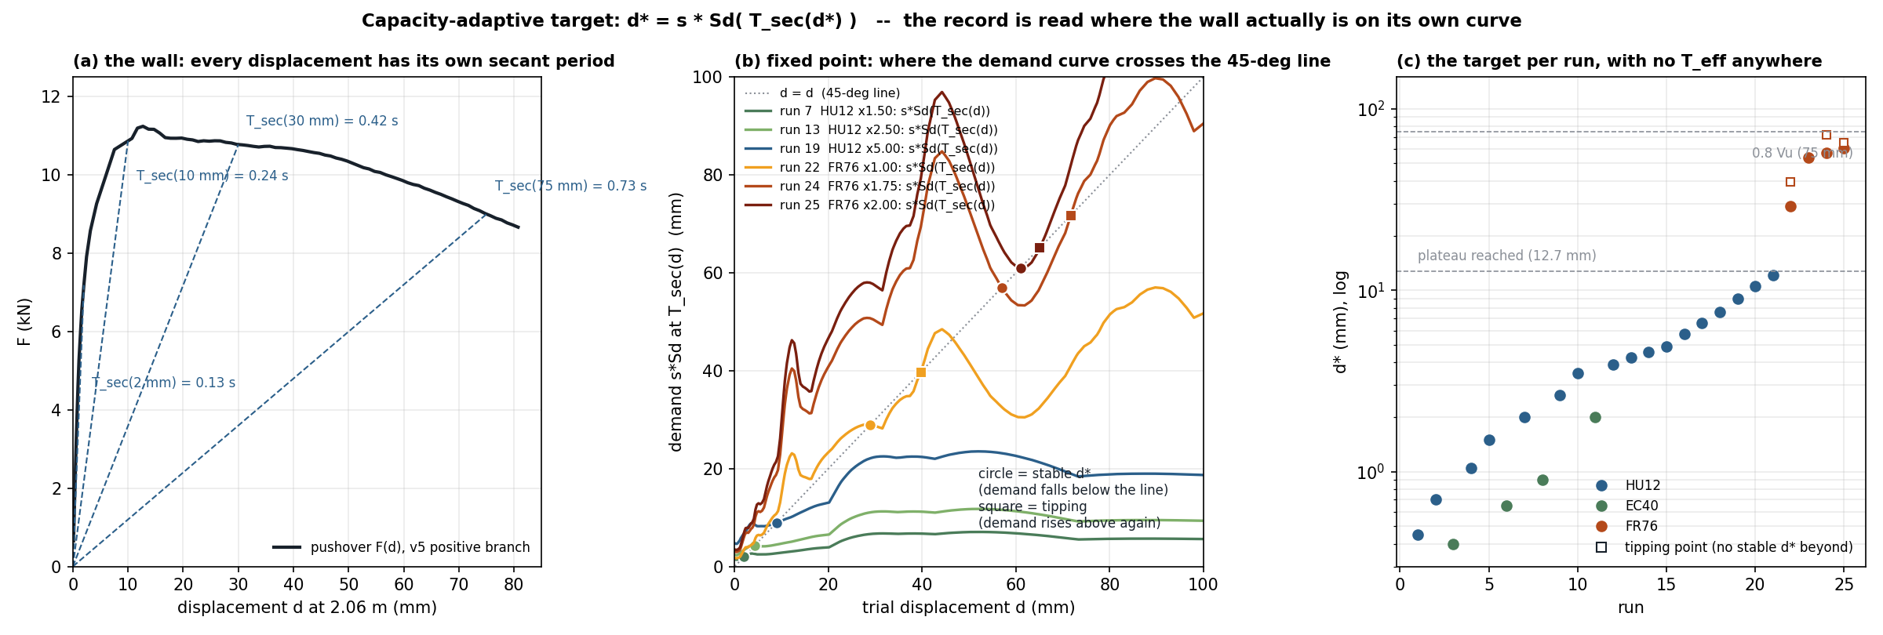
Read the record where the wall sits on its own curve
4 · THE CAPACITY-ADAPTIVE TARGET
(a) every displacement has its own secant period, T_sec(d) = 2π√(m_eff·d/F(d))
(b) d* = s·Sd(T_sec(d*)): crossing from above is stable; from below is a tipping point
(c) one target per run; T* = T1·√μ_run — the bilinear is the case μ_run = μ_ultimate
Figure at m_eff = 1635 kg; the driver matches m_eff to the measured T1 (1406 kg), shortening T* by 7 %
Notes:
This was already computed in Method 2 step 1 on the old backbone, but wave B was fed from the T_eff column. The change is which column feeds the wave.

Slide 13
Before the run: find d*. After the run: check it.
4 · THE EQUATIONS, RUN BY RUN
BEFORE — TARGET
AFTER — CHECK
T_sec(d) = 2π √( m_eff · d / F(d) )
secant period on the backbone
d_ach / d*
did it get there
G(d) = s · Sd( T_sec(d) )
T_ach / T*
record demand at that period
at the period the backbone said
G(d*) = d*
scanned, not iterated
T_ach = 2 · |t_peak − t_opp|
duration of the largest swing
T* = T_sec(d*)
wave B target: d* at T*
F(d): v5 pushover at 2.06 m · m_eff 1406 kg (T_sec at the first point = T1 0.103 s) · Sd 5 %-damped · wave A target s·Sd(T1); both amplitudes fitted jointly
Notes:
Four lines before, three after. The checks are logged, never fed back.

Slide 14
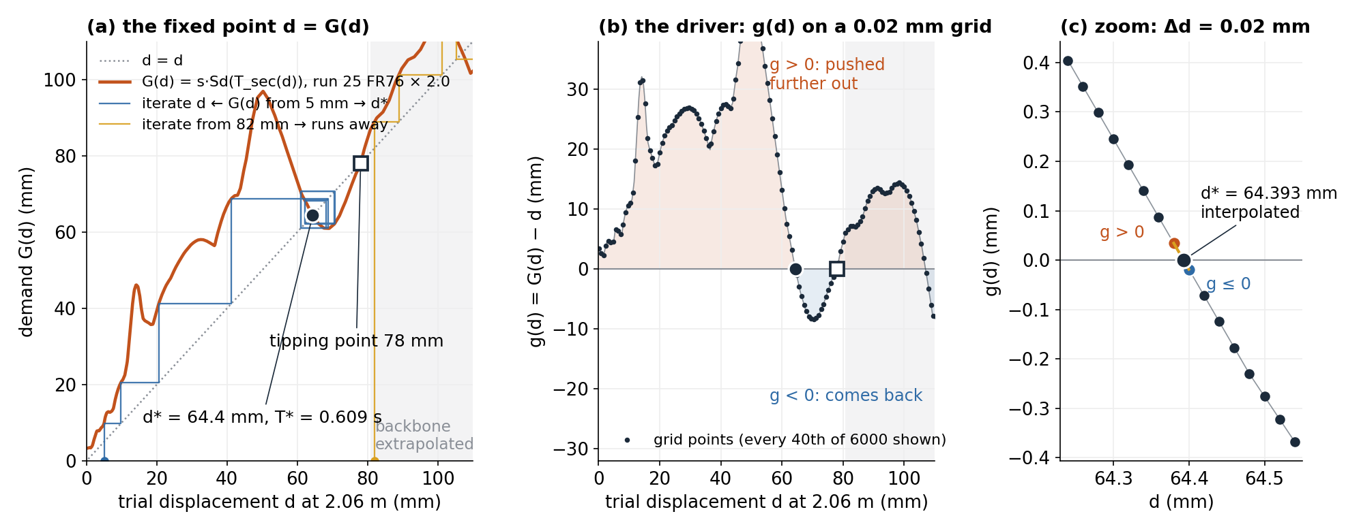
A fixed point in principle, a root scan in the driver
4 · THE SCAN, RUN 25 (FR76 × 2.0)
(a) iterating d ← G(d) reaches only the stable crossing · (b) the driver scans g(d) on 6000 points and keeps every sign change · (c) d* interpolated between the bracketing pair · grey: backbone extrapolated beyond 81 mm
Notes:
Two different jobs: the fixed point decides what to target, the Newton fit decides how hard to shake to hit it. Crossings in the grey band are not trusted; the longer or negative pushover removes that band.

Slide 15
The record’s carrier cannot deliver the target once the wall has softened
4 · A FINDING FROM THE PREFLIGHT
Wave B at the record’s T_p = 0.26 s, target 60 mm at T* = 0.6 s
Wave B carrier at max(T_p, T*), cycles and phase from the record
1.5–1.7 g
0.33–0.46 g
2.5–2.8× the record’s PGA. Frequency ratio 2.3 → amplification 0.23; the oscillator gets a kick, not a cycle.
0.6× the record’s PGA, both targets met exactly. The v13 default; the record-T_p variant stays switchable.
“Periods from the record” holds while T* ≈ T_p — HU12 to about run 14 — and breaks when the wall’s secant period leaves the record’s band.
m2fp_targets_preflight_v5backbone.csv · HU12 × 5.5–6.0 also exceed 1 g with the record carrier
Notes:
The strongest single result of the preflight. It reconciles Ihsan's "periods from the record" with the capacity-adaptive target by letting the carrier follow the wall only once the wall has left the record's band.

Slide 16

Fixed-point targets on the v5 backbone, m_eff matched to T1
4 · THE TARGETS THE DRIVER WILL RUN
Run | Record × s | d* (mm) | T* (s) | Tipping (mm) | Waves | PGA (g) | / record
1–6 | HU12, EC40 small | 0.4–1.1 | 0.10–0.11 | – | A only | 0.07–0.17 | ~1.0
7–14 | HU12 × 1.5–2.75 | 1.6–4.8 | 0.12–0.17 | – | B only | 0.22–0.33 | 0.9–1.1
19 | HU12 × 5.0 | 8.3 | 0.208 | – | A + B | 0.51 | 0.78
21 | HU12 × 6.0 | 10.9 | 0.234 | – | A + B | 0.68 | 0.87
22 | FR76 × 1.0 | 4.5 | 0.163 | 5.0 | A + B | 0.21 | 0.60
23 | FR76 × 1.5 | 58.3 | 0.571 | – | A + B | 0.33 | 0.62
24 | FR76 × 1.75 | 61.2 | 0.590 | 89 | A + B | 0.39 | 0.64
25 | FR76 × 2.0 | 64.4 | 0.609 | 78 | A + B | 0.46 | 0.65
Run 22 is ill-conditioned: the FR76 demand runs along the 45° line from 5 to 40 mm, so d* is 4.5 mm with m_eff matched to T1 and 29 mm with 1635 kg.
Preflight of route2_m2_fixedpoint_v13 · carrier max(T_p, T*) · joint fit on both targets; a single wave where it already covers both · record PGA: HU12 0.13 g, FR76 0.35 g at × 1
Notes:
Expectation: HU12 targets up to run 18 sit at or below the 2 to 4 mm floor; divergence from the control should appear at runs 19 to 21 as a capacity effect. If not, the one-cycle wave B is the problem, not the target.

Slide 17

1.5 % Maxwell, flat from 1 to 25 Hz
4 · DAMPING, MEASURED ON THE WALL ITSELF
ξ = 0.0002
2.7 % ≠ 1.5 %
+1.8 %
undamped ring-down
three equal units superpose
stiffness from the units
9.70–9.83 Hz. The old “no damping” runs were effectively undamped.
The MATLAB-optimised triplet holds 1.4–1.66 % across the band.
T1 0.103 → 0.102 s, inside the carrier’s grid rounding.
Still to run: ring-down v2 with the final triplet; Maxwell on/off at run 19 from the control’s run-18 save.
block mech damp maxwell 0.0112 1.0005 0.0081 7.4315 0.0096 25.0004 · 0.85 % variant 0.0054 1.0000 0.0050 5.3870 0.0053 25.0002
Notes:
Damping is now a measured property of the model, not a setting. The 1.5 percent is a choice; that it is 1.5 percent across the band is verified.

Slide 18




Two sequences in 3DEC, one check built into each run
5 · WHAT IS RUNNING NOW
Control, Strategy F
Fixed-point Method 2, from save 21
After every run
25 records on the ft0 build, large strain, Maxwell 1.5 %. The new reference.
achieved / d*, and T_achieved against T*. Amplitude and period both met → the SDOF reading holds.
FR76 22–25 from the old control’s state, as saved. A mechanism check, not the score.
Queued: full 25-run fixed-point sequence from the ft0 save · negative-branch pushover · model “Table 5” offline with the paper’s §3.2 procedure · bilinear kept as the standard variant.
Strategy C is not revisited as a surrogate: its feedback variable, the small-amplitude period, does not move on an unbonded wall
Notes:
The control run is the one that matters for the paper; the from-21 run buys an early look at FR76 behaviour while it finishes.

Slide 19
What the method cannot see, and what we are waiting on
5 · OPEN QUESTIONS, STATED AS SUCH
Item | Why it matters | Status
Eq. 2 masses behind 29.5 kN | Test capacity ~10 or ~30 kN; everything above rests on ~10. | Pending Alvand’s reply
FR76 × 1.0 fixed point | d* anywhere in 5–40 mm depending on m_eff. | Reported as a property of the method
Cycle accumulation | One d* cannot see how many strong half-cycles the record delivers. | Method 2b if pursued
Top-joint sliding in the pushover | Part of the plateau is top-joint friction, not wall kinematics. | Check against Fig. 15 shapes
Period elongation | Test +17.5 % from run 1; the ft0 model should stay near 0.103 s. | Offline Table 5 after the control
Old results and deck | All on the bonded, over-strong wall. | Rewrite queued
Paper options unchanged: validation + experiment re-read with Moshfeghi · surrogate with regimes · limits of SDOF reasoning for a rocking wall
Notes:
Close on the honest version: the method now sits on a wall that matches the test and the hand calculation, with a target that follows the wall's own curve. The known blind spots are findings for the paper, not things to tune away.

